Slide 1
Migration Assessment & Strategy Workshop

Slide 2
Tech leaders are to the right of the Data Maturity Curve
From hindsight to foresight
Supporting the business
Automated Decision
Making
Prescriptive Analytics
Predictive Modeling
Automatically make the best decision
Competitive Advantage
Data Exploration
How should we respond?
Ad Hoc Queries
What will happen?
Reports
Clean
Data
What happened?
Powering the business
Data + AI Maturity

Slide 3


Why not use a cloud data warehouse?
Data Warehouses can’t fully support all your data
Structured
Semi-Structured
Unstructured
Limited support for unstructured data (audio/images/video)
ADLS S3 GCS
DATA LAKE
Lock-in / proprietary format
Data is replicated

Slide 4
Why not use a cloud data warehouse?
Data Warehouses are inefficient with data transformation
Up to 6x the cost for ELT workloads
Not optimized for
Data Engineering
Structured
Complex & many stages.
Semi-Structured
Limited support for streaming
Unstructured
Limited support for unstructured data (audio/images/video)
ADLS S3 GCS
DATA LAKE
Lock-in / proprietary format
Data is replicated

Slide 5



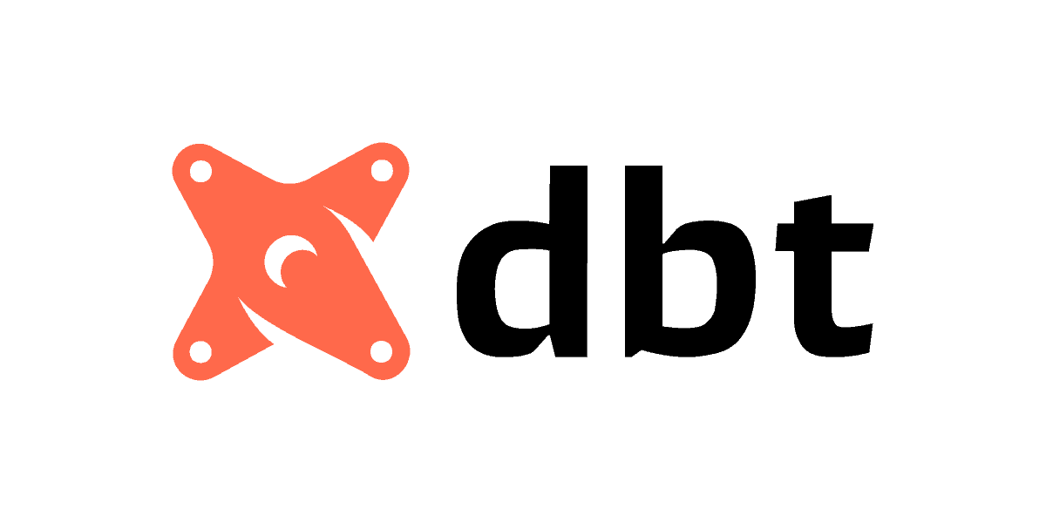
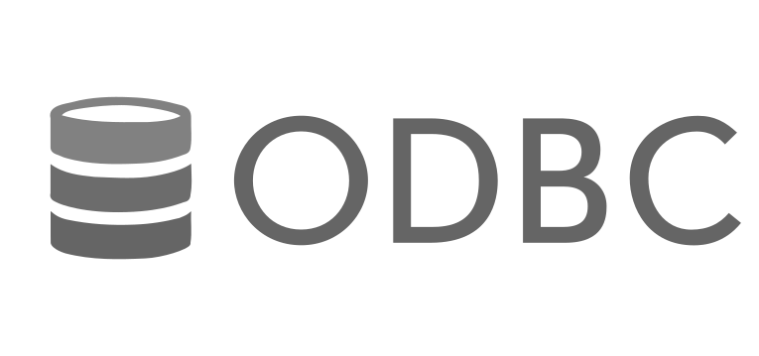




Why not use a cloud data warehouse?
Pay a premium for all workloads
Up to 6x the cost for ELT workloads
Compute cost for all data access
BI Reports, Dashboards & SQL ELT
Not optimized for
Data Engineering
Structured
Complex & many stages.
Semi-Structured
Incompatible security and governance models
Limited support for streaming
Unstructured
Limited support for unstructured data (audio/images/video)
ADLS S3 GCS
DATA LAKE
Lock-in / proprietary format
Data is replicated

Slide 6



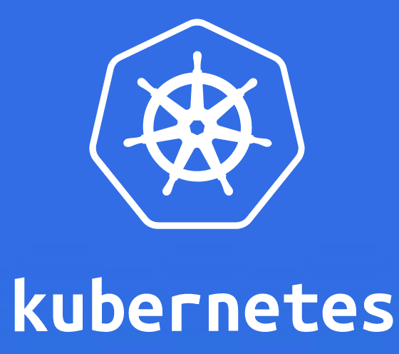
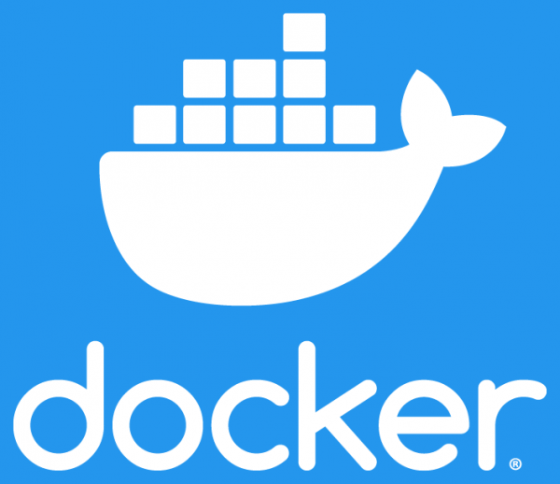



Why not use a cloud data warehouse?
A cloud data warehouse is NOT a modern data platform
Up to 6x the cost for ELT workloads
Compute cost for all data access
BI Reports, Dashboards & SQL ELT
Not optimized for
Data Engineering
Structured
Complex & many stages.
Semi-Structured
Incompatible security and governance models
Model Serving
Limited support for streaming
Not optimized for
Data Science
Unstructured
Limited support for unstructured data (audio/images/video)
Data is duplicated
ADLS S3 GCS
ADLS S3 GCS
Data Science
Model Training
DATA LAKE
Lock-in / proprietary format
DATA LAKE
Data is replicated
Model Scoring
Model Deployment
Disparate tooling decreases data team productivity

Slide 7




The Databricks Lakehouse Platform
✓
Single Source of truth for all your data
Integrated and collaborative role-based experiences with open APIs
✓
End-to-end ETL and Streaming capabilities
BI & SQL
Data engineering / Streaming
Data science & ML
✓
High performance BI on your data lake
Common security, governance, and administration
✓
First-class AI/ML capabilities and support
Data processing and management built on open source and open standards
✓
Open, unified governance and security
Cloud Data Lake structured, semi-structured, and unstructured data
Notes:
We've achieved delivering analytics on the lakehouse with world-class performance and data lake economics.
But the benefits are more than simply building a DW on a DL - now you can run all data BI and AI workloads on one source of truth for ALL your data - without vendor lock-in

Slide 8


Simple Migration Process
Inefficient DE, ETL, Data Sharing (Snowpipe / Snowpark, Partner Integrations)
Delta Lake / Live Tables / Sharing
(Industry-leading data engine, multiple language support)
Limited Real-Time Event Processing (Batch Processing in Snowpipe)
Databricks Jobs / Delta Lake / Structured Streaming
(Spark Structured Streaming + Delta Lake: Streaming + Batch ingest)
Slower, More Expensive SQL / BI (SQL UI, BI Connectors)
Databricks SQL (Native SQL support, SQL Endpoints, Optimized BI Integrations)
Non-Native DS / ML (Dataiku, DataRobot, External Snowpark Scripts)
Databricks Machine Learning / MLFlow
(Data native, first-class DS / ML platform, multiple language support)
Required Partner Tools (Filling in the Gaps)
Open Architecture (Easy integration with all required tools, access to open-source community)
Notes:
Many customers have migrated away from a Snowflake-centric architecture into a Databricks Lakehouse architecture. Overall, the migration process is pretty seamless and very beneficial for you.
On the Snowflake side, you will see many of the most common problems that we see companies run into when building around Snowflake. (At this point, highlight the ones that are most important to the customer).
When moving to a Databricks architecture, customers can benefit from a variety of tools included in our platform that encompass the entire data and AI lifecycle. (Highlight the most important sections for the customer).

Slide 9





Migration Methodology
Phase 1 Discovery
Phase 2
Assessment
Phase 3
Strategy
Phase 4
TurnKey Delivery Proposal
Phase 5
Execution
Migration specific discovery and consultation
Assessment, Design, Tooling, Accelerators, Sizing, Partners
Technology mapping, migration workshop, migration planning
Reference implementation of a production use case, Overall migration implementation plan
Migration execution and support
Databricks Migration Team with/without Partner
Databricks Partner Driven
Databricks PS Driven ( Assurance Package to assist SIs)

Slide 10
Discovery & Assessment

Slide 11
Architectural Discovery - Snowflake
Begin with a review of the customer’s current Snowflake architecture
ETL Environment
Third-party Tools? (Fivetran, Talend, dbt, etc.)
Data velocity
Data Types
BI Processes
BI Tools
Report/Dashboard requirements
ML Use Cases
Scale of use cases
Model requirements (languages, libraries, compute)
Use our Snowflake Profiler to understand current workloads; Partner Analyzers for deeper dive
Snowflake Migration Scoping Questionnaire (leave behind)
Notes:
PC - , stored prcs, views..

Slide 12
Pointers for discovery of the current Snowflake architecture
Understand the landscape
Existing architecture
Pain points? (ETL, DSML, streaming, etc.)
Upstream and downstream teams / partners
Consider the TCO of their architecture
Inefficiencies? Data movement or copying?
Look for unserved use cases or teams
Current use cases not possible in Snowflake’s Data Cloud
Future use cases you could serve in the Lakehouse

Slide 13
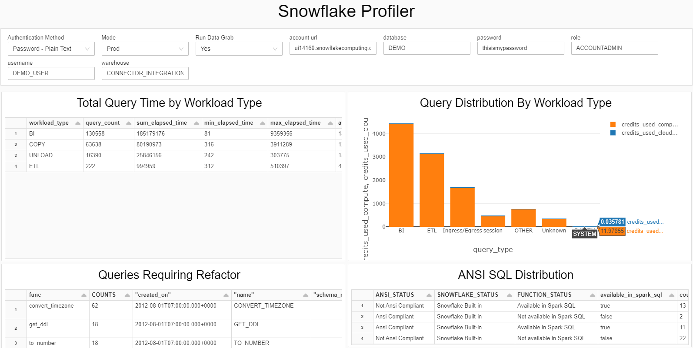
The Snowflake Profiler is an important step
The Snowflake Profiler is a notebook which runs in your environment to answer core questions:
What is the breakdown of my Snowflake usage by category?
Where are these workloads running? (Which warehouse, which users?)
How do we expect these costs to grow over time?
Reach out to your Partner Account Manager, Sales Leader, or email partners@databricks.com to engage your Databricks counterparts.

Slide 14
Align on Target Architecture
Designing a Well Architected Lakehouse

Slide 15






Guiding Principles for the Lakehouse
Curate Data and Offer Trusted Data-as-Products
Adopt an Organization-wide Data Governance Strategy
Remove Data Silos and Minimize Data Movement
Encourage the Use of Open Interfaces and Open Formats
Democratize Value Creation through Self-Service Experience
Build to Scale and Optimize for Performance & Cost
Notes:
Curate Data and Offer Trusted Data-as-Products
Curating data is essential to create a high value data lake for BI and ML/AI:
Treat data like a product with a clear definition, schema, and lifecycle
Ensure semantic consistency and that business users can fully trust the data
Remove Data Silos and Minimize Data Movement
Eliminating data silos is another important principle for building a trusted data lake:
Don’t create copies of the same data with business processes relying on these different copies
They become data silos that will get out of sync, leading to outdated or even incorrect insights.
Democratize Value Creation through Self-Service Experience
Users must be able to work with data and platform for their BI and ML/AI tasks easily:
Lower the barriers to access data and platform for all business units.
This can be enabled through lean data management processes and self-service access, …
Adopt an Organization-wide Data Governance Strategy
Data is a critical asset of any organization:
It must be actively managed.
Access control, auditing and lineage tracking are key for the correct and secure use of data.
Encourage the Use of Open Interfaces and Open Formats
Open interfaces and data formats are crucial for interoperability between Lakehouse and other tool:
Simplifies integration with existing systems.
Opens up an ecosystem of partners who have integrated their tools with the Lakehouse platform.
Build to Scale and Optimize for Performance & Cost
Data will grow:
To be prepared for the future, take advantage of Lakehouse's scaling capabilities.
Use these features to get insights faster and to optimize for performance and costs.

Slide 16
Cloud Data Analytics Framework
Data Engineer
ML Engineer
Data Scientist
Business Analyst
Business Partners
ETL & DS tools
BI Tools
Data Sharing
Consumption
Workflow Mgmt
Ingest & Transform
Advanced Analytics, ML & AI
Data Warehouse
Engine
Data Governance
Governance
Cloud Storage
Storage

Slide 17









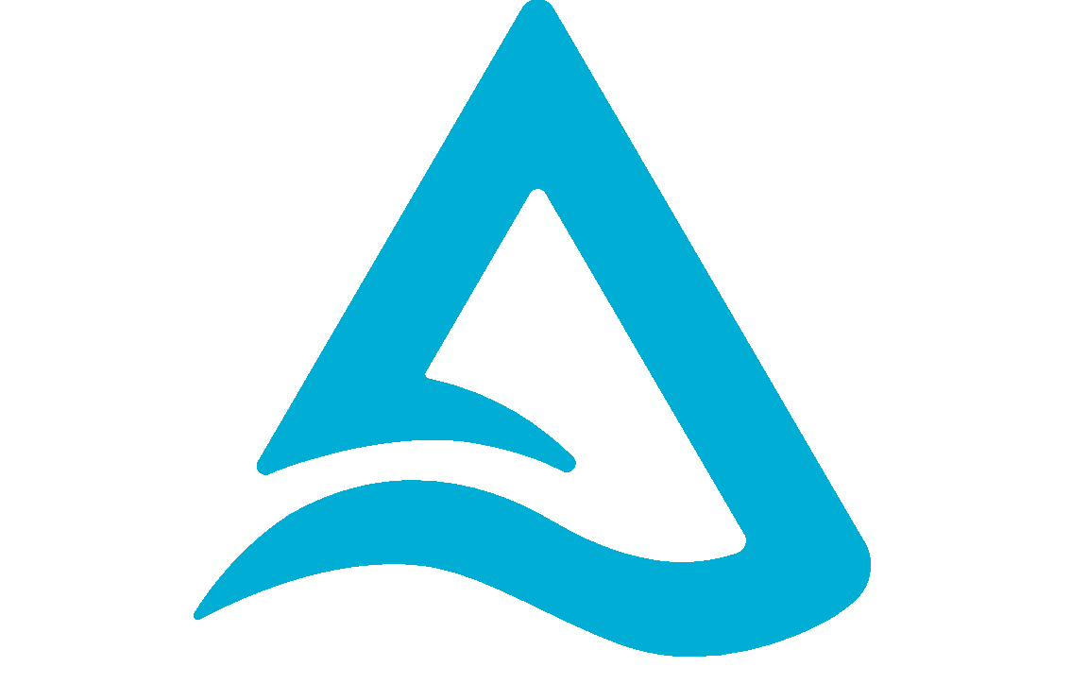
Cloud Data Analytics Framework
Data Engineer
ML Engineer
Data Scientist
Business Analyst
Business Partners
ETL & DS tools
BI Tools
Data Sharing
Consumption
IDE support
Notebooks
SQL Editor
Delta Sharing
Workflow Mgmt
Ingest & Transform
Advanced Analytics, ML & AI
Data Warehouse
Workflows (Jobs, DLT)
Auto Loader, DLT
Databricks Runtimes
ETL runtime
ML runtime
Model Serving
SQL Connectors
Engine
Batch
SQL Warehouse
Data Quality (DLT)
Streaming
Photon
Data Governance
Governance
Unity Catalog
Cloud Storage
Amazon S3
ADLS
Google Cloud Storage
Storage
Supported:
Proprietary DWH files
Delta
Parquet
JSON
CSV
Avro
Images
. . .

Slide 18
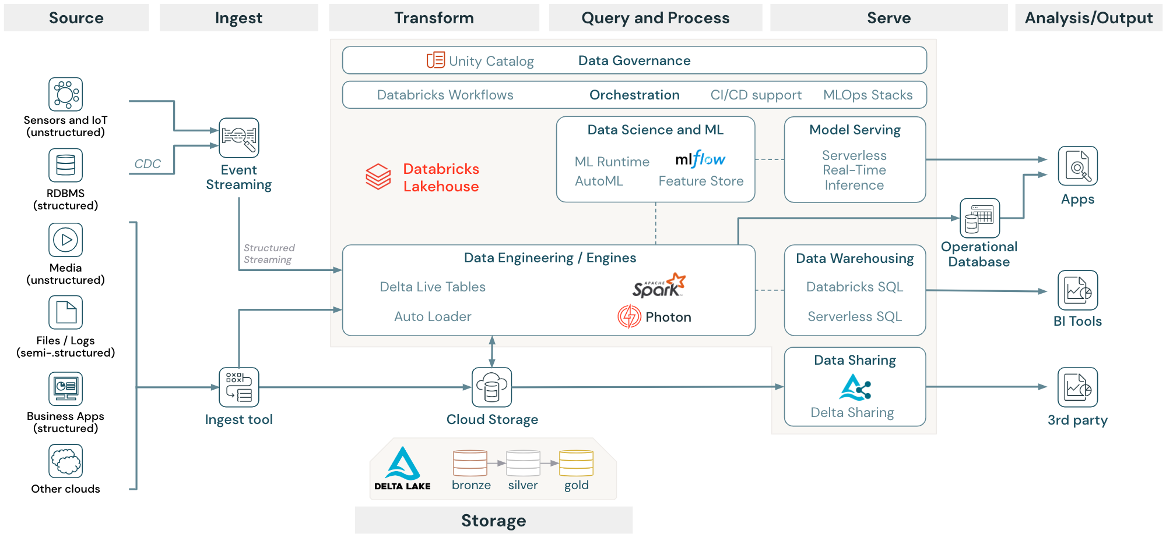











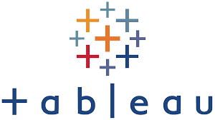





Databricks Lakehouse Reference Architecture
The Databricks Lakehouse Platform can support your core data workloads
Optional DW

Slide 19
Different Data Models on the Lakehouse
The Lakehouse supports any data model
Data Models are organizational processes. You cannot buy a process!
However, the right platform capabilities will ease the implementation of a particular data model
Databricks Lakehouse has the technical enablers for teams to produce and consume data in a centralized or decentralized but governed way
Lakehouse is a polyglot technology that works with any data modeling concept
Lakehouse applies at all scales (startups to large orgs)
The Medallion architecture can fit into whatever strategy you want
BRONZE
Replica of Source mainly for landing, archiving, re-processing and Lineage Purposes
SILVER
More normalized (2NF-like) / Data Vault-like / Write-optimized
GOLD
Integration Layer
Star schema/ Kimball / Read-Optimized

Slide 20
A Well Architected Lakehouse
animated
Dimensional Modeling
Landing (Autoloader)
silver
gold
Staging
Raw data in its original format (temporarily)
Ingestion
Raw data converted to Delta (from Avro, CSV, parquet, XML, JSON format in Landing)
Integration -Physical data model
Detailed information covering multiple subject areas
Integrates all data sources
Does not necessarily use a dimensional model but feeds dimensional models.
Data Mart
Subset of the Integrated layer, sometimes or aggregated data
Focus on dimensional modeling with star schema
Typically oriented to a specific business line or team
Staging
Enterprise ODS/ Integration
Presentation
raw data (temp.)
Data Mart
Product Domain
IoT, Social Media Data
Dim. Model
Customer Domain
Sales
bronze
Data Mart
Ingestion
raw data
Physical Data Model
Dim. Model
Dimensional model (star schema)
Order
Customer
Dim
Fact
Dim
Product
Implementing Data Modeling Techniques in the Databricks Lakehouse Platform
Data Modeling Best Practices in the Databricks Lakehouse Platform
Dim
Time
Notes:
Level: 300

Slide 21
A Well Architected Lakehouse
animated
The Data Vault 2.0
Landing
silver
gold
Staging
Raw data in its original format (temporarily)
Ingestion:
Raw data converted to Delta (from Avro, CSV, parquet, XML, JSON format in Landing)
Integration - Raw Vault: Data is modeled as
Hubs (unique business keys)
Links (relationship and associations)
Satellites (descriptive data)
Integration - Business Vault: Tables with applied business rules, data quality rules, cleansing and conforming rules
Business views
Point-in-Time (PIT) tables (opt.)
Bridge tables are created on top of the business vault (opt.)
Presentation - Information Marts
Similar to a classical Data Mart with data that has been cleansed and harmonized
Consumer-oriented models (typically views)
Staging
Enterprise ODS/ Integration
Presentation
raw data (temp.)
Information Mart
Raw Vault
Business Vault
Hub
PIT
Business Views
SQL
bronze
Link
Bridge
Ingestion
raw data
Satellite
Views
ETL/ELT
Data Vault 2.0 model
Satellite
Satellite
Satellite
Satellite
Hub
Link
Hub
Customer
Product
Satellite
Satellite
Hub
Order
Satellite
Satellite
Notes:
Level: 300

Slide 22
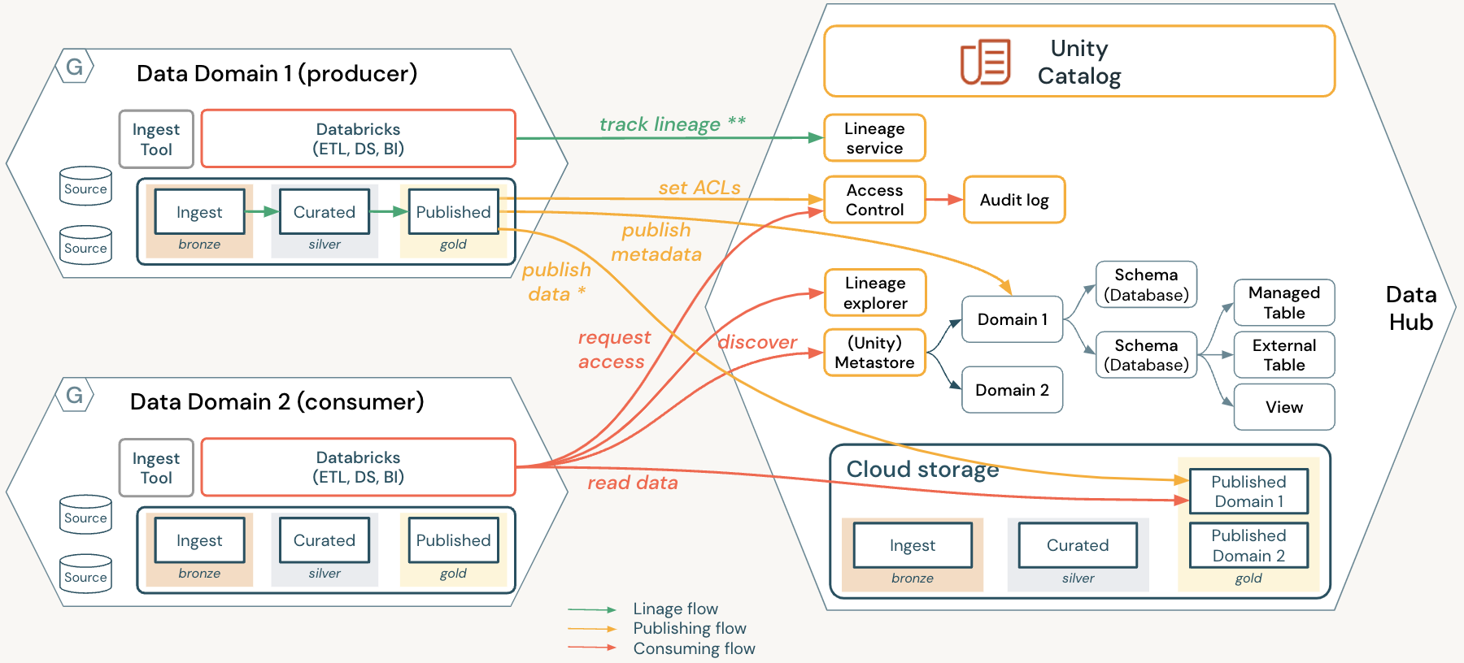
A Well Architected Lakehouse
animated
The Data Mesh
Data Domain ownership: The lakehouse provides an open, flexible architecture that allows for distributed ownership of data assets for each domain
Data as a product: Delta provides an open and standard format for FAIR data, and Delta Live Tables allow for high quality, reliable data pipelines
Self-service infrastructure platform: Databricks is a unified platform that can automate data processes through the use of Workflows, Terraform, and other tools
Federated governance: Unity Catalog ensures global data discovery, access, and lineage
* Batch process with CDF, DLT, … ** currently lineage is restricted per workspace
Notes:
Level: 300

